Slide 1
Arkansas Department of Health New Employee Orientation

Slide 2
Welcome to NEO!
NEO is a web-based series of courses located on TRAIN, the ADH learning management system (LMS).
All ADH employees are required to complete the initial eleven courses within ten days of hire.
Once the initial eleven courses are completed, the new employee has other courses that should be completed in the next one to six months time frame. Those additional courses are outlined on the HR-30 form. The HR-30 can be located in the Resources Tab of this course.

Slide 3
Table of Courses
Course ID # | Course Title | Pre test | Post Test
1102885 | Orientation to ADH and Public Health | NO | NO
1009552 | ADH HIPAA Privacy & Security TRAINING | NO | YES
1074637 | ADH Cybersecurity & Awareness TRAINING (Now offered through KNOWB4 w/ IT) | NO | YES
1069498 | FOIA & HIPAA | NO | YES
1090733 | Payroll/Benefits | NO | NO
1090734 | HR Policies and Procedures | NO | NO
1067054 | Basic Blends – Cultural Awareness | YES | YES
1065034 | Basic Blends – Customer Service | YES | YES
1067070 | Basic Blends – Teamwork I Insight Inventory | YES | YES
1090104 | Workplace Safety | NO | YES
1089719 | The Media & You | NO | YES
1087627 | IT Orientation | NO | YES
1102885 | Orientation to ADH and Public Health | Complete Evaluation

Slide 4
Your TRAIN Account
Instructions to set up your TRAIN account were in the initial email.
Group settings are very important in TRAIN. Please make sure you choose Arkansas and Arkansas Department of Health as two of your groups. You can choose as many groups as you would like – the groups should be indicative of education areas you would like to obtain learning from. CDC is an obvious choice for all new employees.
Once you establish a TRAIN account, it is always yours. No matter if you work for ADH or not. If you are unable to get into your TRAIN account, call or email the TRAIN administrator.
Once your AASIS number/employee identification number is assigned, enter it into the appropriate tab in your TRAIN profile.
If you are a nurse, please enter your nursing license number into the appropriate tab in your TRAIN profile.
Once you receive a FEMA identification number, enter it into the FEMA tab in your TRAIN profile.

Slide 5
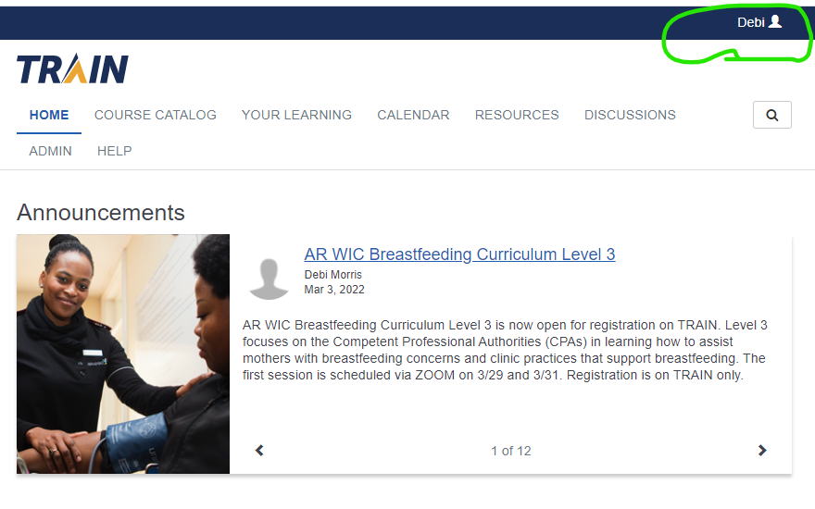
TRAIN Parts and Pieces
This is your profile button. This is where you enter your demographic information, nursing license number, FEMA number, etc.
This is also where you choose your groups.
Remember – this account ALWAYS belongs to you!

Slide 6
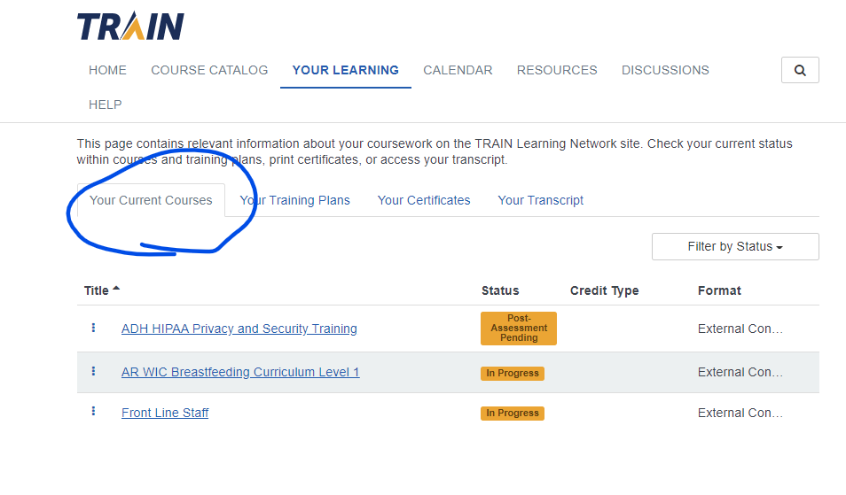
You have courses?
Any courses in progress are located here. If there are three dots to the left of the title, click on them.

Slide 7
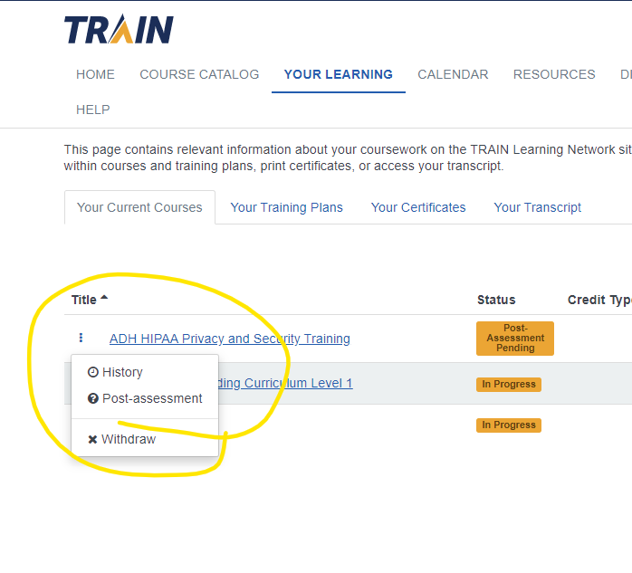
THREE DOTS …
Those three dots open up several options for you. Once this post-assessment is completed, the “Print Certificate” option will be available.

Slide 8
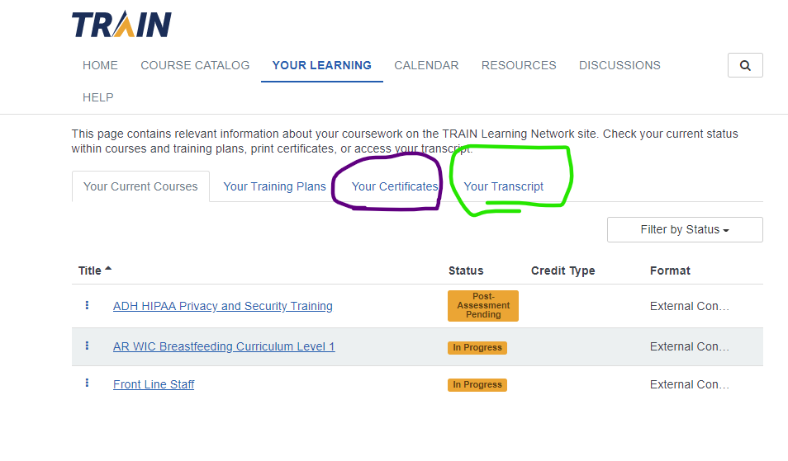
Certificates are housed here. Some courses do not offer a certificate.
Your transcript contains every course you have taken on TRAIN.

Slide 9
AASIS
AASIS stands for Arkansas Administrative Statewide Information System.
AASIS is responsible for Personnel Management, Employee Benefits, and Budgeting to name a few of its functions.
Each employee has a unique AASIS number/employee identification number and once it is assigned, that will always be your number no matter what state agency you work for.

Slide 10
Benefits and Payroll
Any questions or issues with Payroll should be addressed with that department. The phone number is 501-671-1438.
Any questions or issues with Benefits should be addressed with that department. The phone number is 501-661-2299.

Slide 11
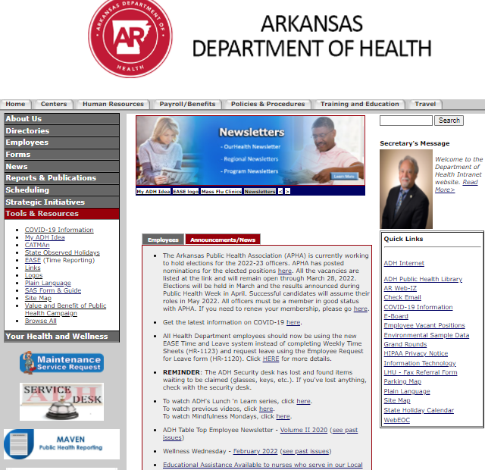
ADH INTRANET
The ADH Intranet webpage has many areas of information available to you.
Take the time to peruse the website and familiarize yourself with it.
The IT Help Desk and the Maintenance Department icons are here for easy access with help requests.

Slide 12
Are you finished?
Once you have completed all eleven courses, please return to this course: Orientation to ADH and Public Health, # 1102885.
Complete the evaluation and let us know your thoughts for improvements.
If you have any questions regarding NEO feel free to call the TRAIN Administrator.
Congratulations and Welcome to the ADH!

